Slide 1

11) Simulation

Slide 2

Simulation is a methodology used to model systems by artificially generating system activities. It is a descriptive methodology in that analysis and solutions are obtained by observing resulting performance measures from the simulation runs. It is a widely used technique to determine solutions that can be applied to problems that would be difficult if not impossible to solve analytically.
Example
Tasty Burger is a QSR in a busy area of a large city. They are planning to open a drive through facility and are interested in knowing the best way to configure the drive through operations (how many service windows will be needed, how should waiting lines be configured, etc.).
To address this they will conduct a simulation study by artificially generating customers through several proposed system configurations and measuring the performance of each configuration.

Slide 3


The first, and most basic, configuration for the example is a single service window. To simulate operations of this system information has been obtained about how customers arrive (arrival distribution), and also how quickly customers are served (service time distribution). The distributions appear below.
Simulations that involve sampling from probability distributions are called Monte Carlo simulations. We want to generate customer arrivals according to the arrival time distribution, and generate service times according to the service time distribution. Mechanisms for sampling from probability distributions are sometimes referred to as process generators.
How can we produce process generators for the above distributions and apply them to artificially run our Tasty Burger QSR with the proposed drive through configuration?

Slide 4


The general idea for creating process generators is to invert the probability distribution and supply uniform random numbers as input to generate the observations from the desired distributions. (e.g, Excel function RandBetween(A,B) will provide uniform random integers between A and B inclusive)
Our example is a basic one, but this basic idea can be applied in general, and to both discrete and continuous probability distributions (more on this later).

Slide 6
Returning to our example, now that we have a method for producing artificial customers to our QSR, we can run operations and observe how well the system performs.
As a basic performance measure, we can keep track of customer wait times and determine the average customer waiting time for the specified drive through configuration.

Slide 7
Simulate operations for the first five customers and determine average customer waiting time, and the average customer time in the system.
Customer Number | Random Number | Time Betw. Arr. | Clock Time at Arr. (opens at 7:00) | Clock Time at Beg. of Svc. | Random Number | Serv. Time | Clock Time at End of Svc. | Waiting Time
1 | 12 |  |  |  | 43
2 | 24 |  |  |  | 73
3 | 3 |  |  |  | 89
4 | 32 |  |  |  | 91
5 | 83 |  |  |  | 40
Process Generators

Slide 8

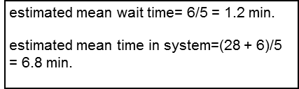

Slide 9

Added application 1)
A firm is planning a new product introduction and is interested in forecasting potential profit. Price is $12 and fixed production cost is $135,000.
It was determined that sales volume can be modeled using a normal distribution with a mean of 65,000 and standard deviation of 15,000.
In addition, it has been determined that the variable cost can be modeled using the uniform distribution on the interval from $8.00 to $10.00.
Profit = ($12 – Variable Cost)*Volume - $135,000
It is desired to simulate profit for 1000 replications and estimate the probability that profit will be positive.

Slide 10
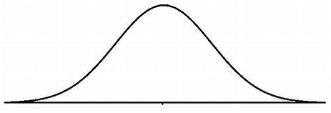
Recall sales volume is to be modeled with a normal distribution having a mean of 65,000 and standard deviation of 15000.
Excel has a built in process generator for the normal distribution that has the following form
=NORM.INV(RAND(), mean, standard deviation)
where RAND() generates random numbers (uniform) on the interval from 0 to 1.
For our example, the process generator will be specified as:
=NORM.INV(RAND(), 65000, 15000)

Slide 11
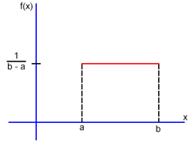
Recall the variable cost distribution can be modeled using the uniform distribution on the interval from $8.00 to $10.00
Using the RAND() function we can generate observations for any interval a, b
(a < b) using the following process generator
= a + (b – a)* RAND()
(Excel has a variety of process generators that can be found by clicking f(x)
The different aspects of the application can be entered into Excel as follows:

Slide 12


Added Application 2)
Frank Miller has decided to leave his employer to become an independent consultant. Being self employed, Frank will be making year end contributions to a SEP IRA retirement account.
Frank expects to be able to make contributions for 30 years, but is uncertain about the yearly amounts and also the annual rate of return. He expects to be able to invest $12,000 each year, and given the uncertainty, assumes that amount to have a normal distribution with a standard deviation of $2,000.
In addition, the rate of return is also uncertain. It is estimated to have a uniform distribution with a range between 2% and 10%.
-How much can Frank expect to have in his retirement fund at the end of the 30 years? (run the simulation for 1000 replications).
-What is the probability that Frank will have more than $1 million in his fund at the end of 30 years?

